Slide 1


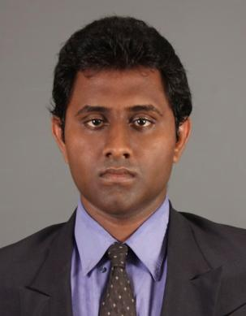
Dialog Customer Complaint Solution
Institute of Engineering Technology Katunayaka
J.R.M.JEEWANDARA
Western North Region, Access Network Planning,
Kaduwela
Dialog Axiata PLC

Slide 2
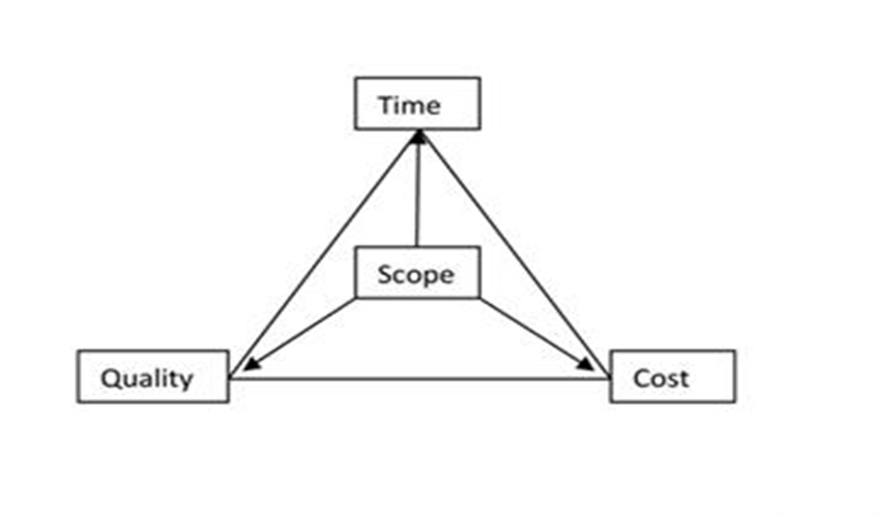
Project Management

Slide 3

PROJECT PROPOSAL

Slide 4




Existing System
Server
Customer Complaint
Support Team

Slide 5
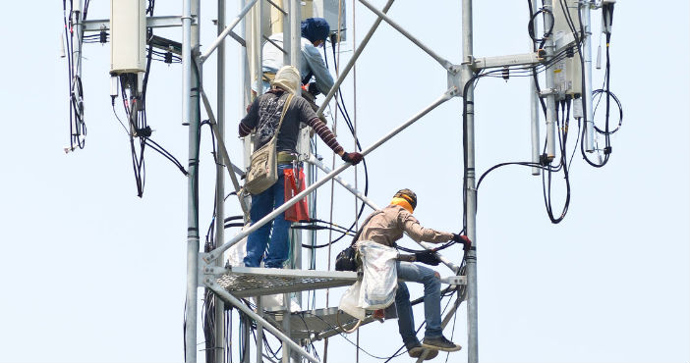
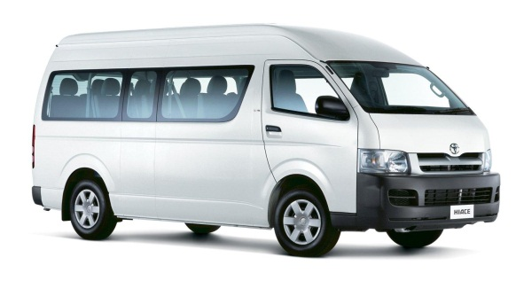

Existing System Solution
Support Team
Visiting Customer

Slide 6
Main Objectives Of The Proposal
Save time,
By handling more complaints.
By not visiting the customer.
By finding the customer location.
Save money,
By not travelling the customer.
By not calling again and again to customer .

Slide 7









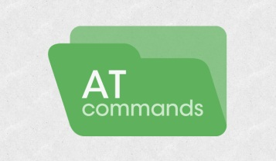


Technical Feasibility
Skills for designing the computer programming languages.
Skills for designing the online sever database programming languages.

Slide 8
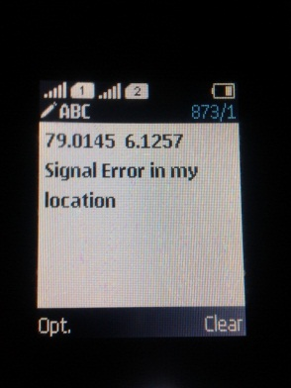
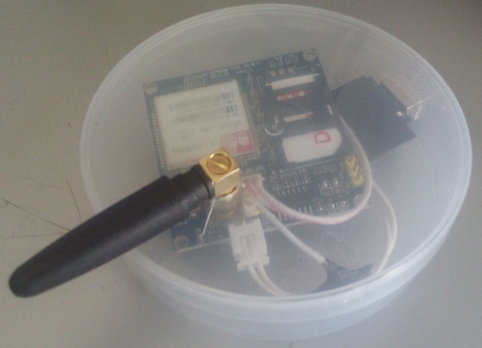
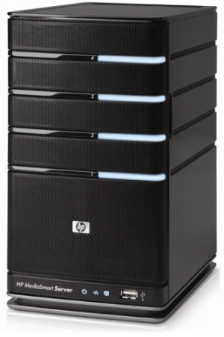
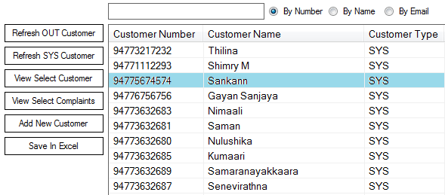
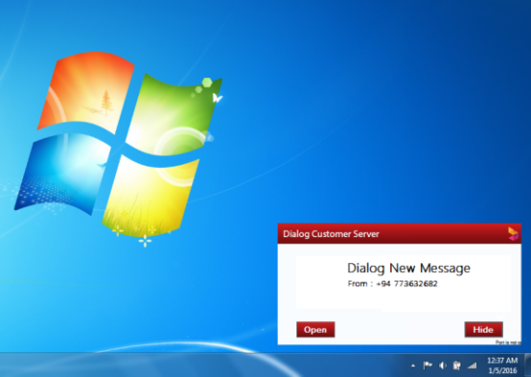
Dialog GSM Server
Dialog GSM SMS server with User Interface.

Slide 9
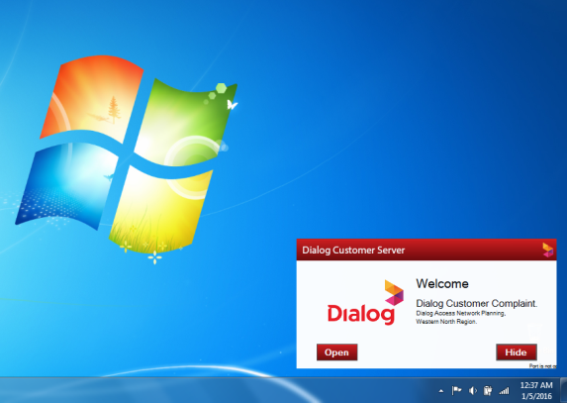
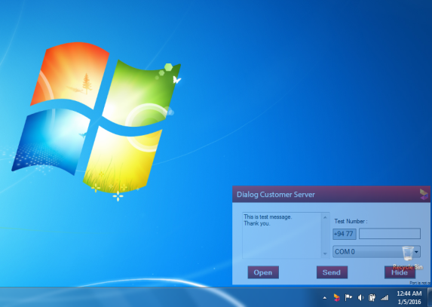
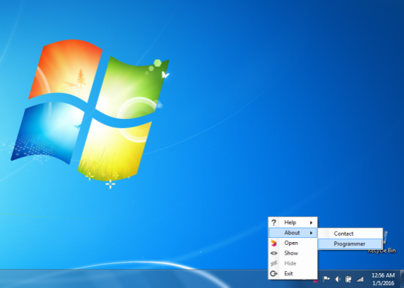
GSM Server Desktop Application
Dialog UGI user interface for dialog antennas, mobile towers and collect them to a database.

Slide 10
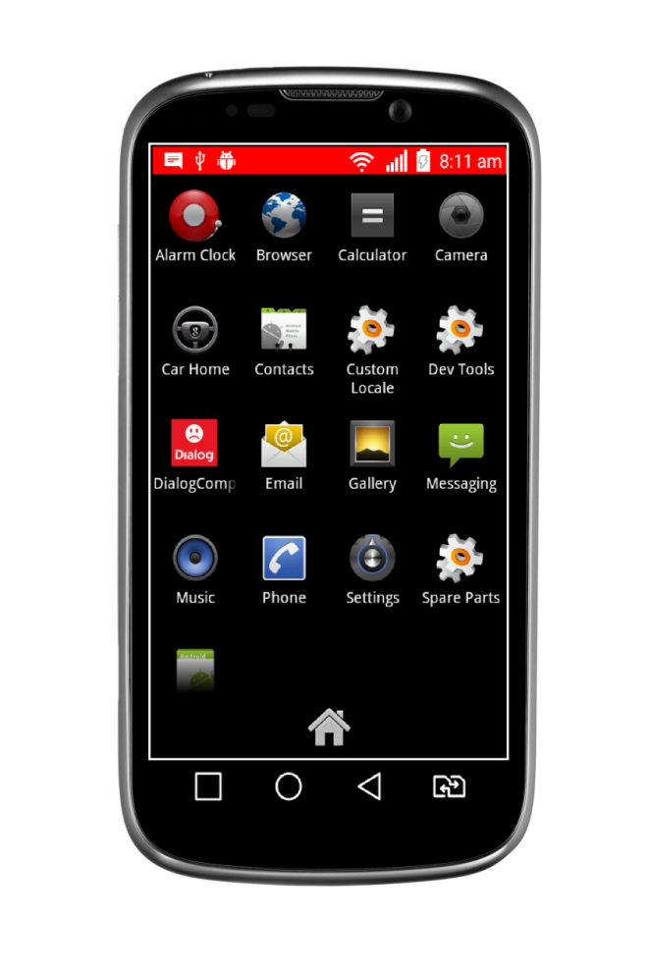
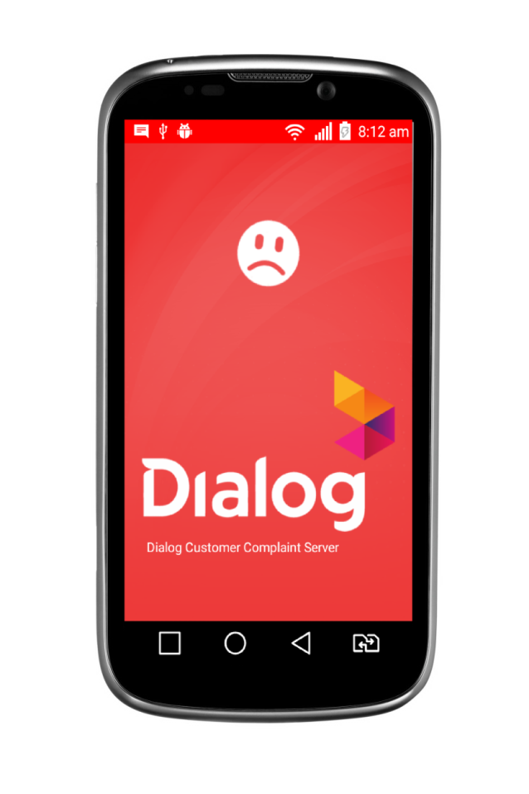

ANDROID APPLICATION
The smart phone application for every versions of android phones.

Slide 11
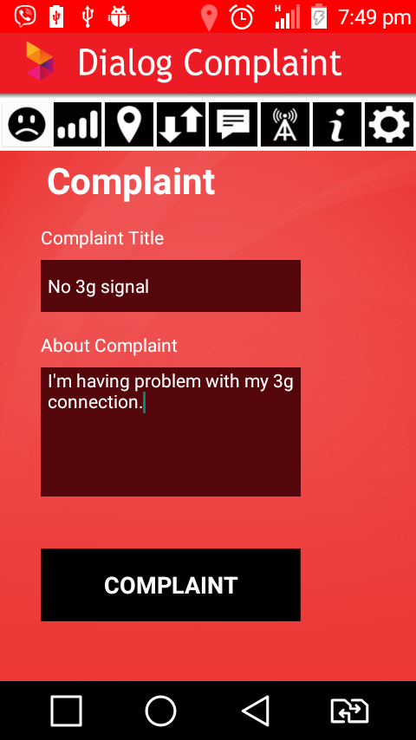
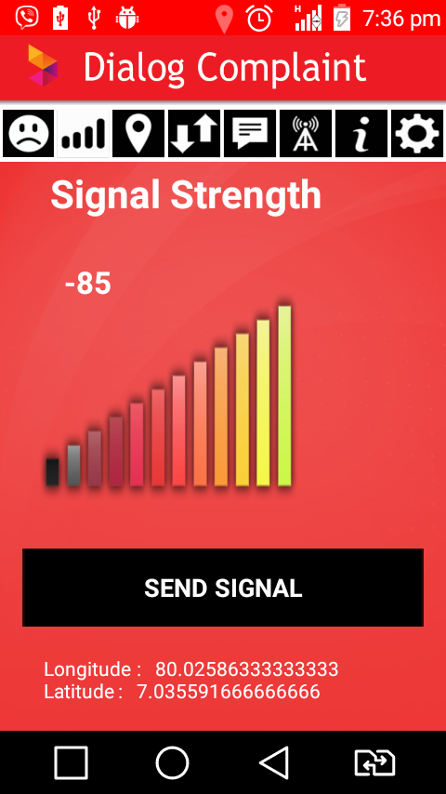
ANDROID APPLICATION
The existing user program to read the data from the smart phone application.

Slide 12
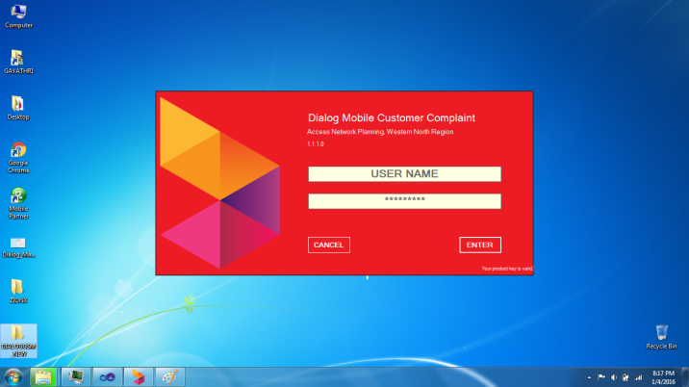
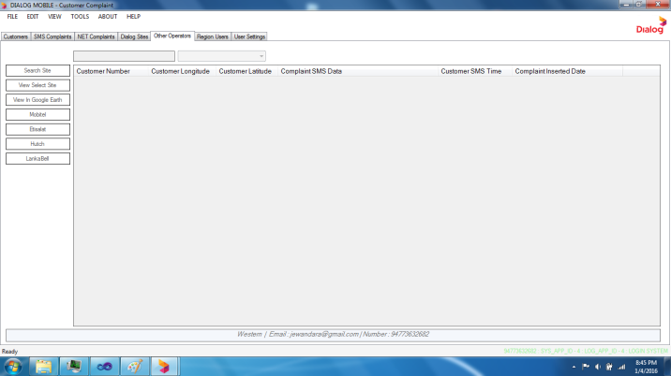
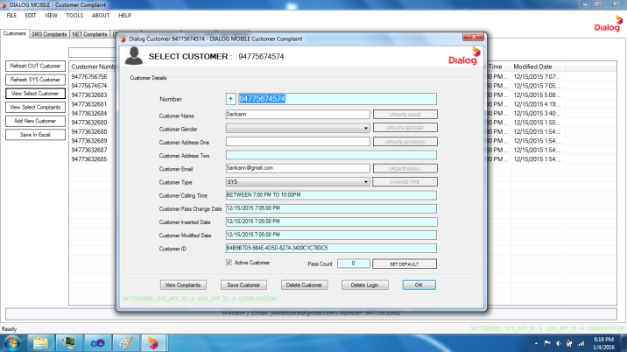
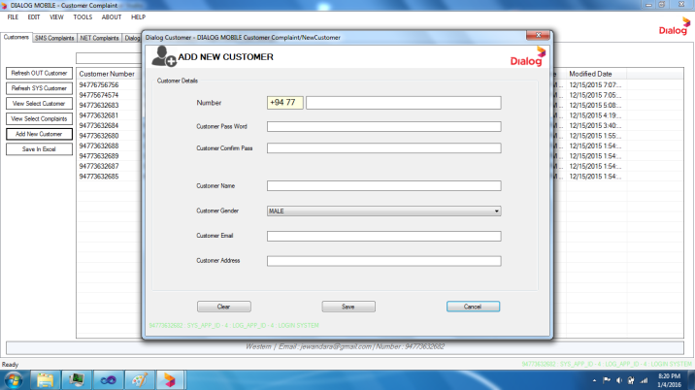
Dialog User Desktop Application
Online server and testing the hole project.

Slide 13
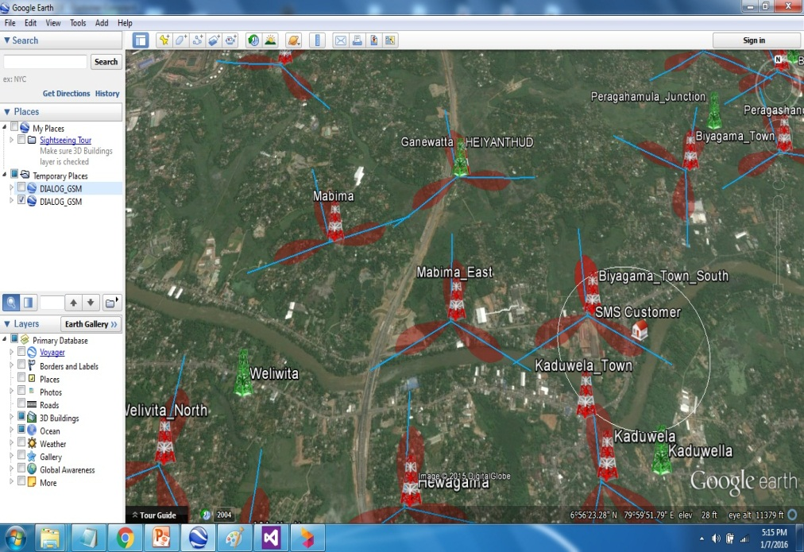
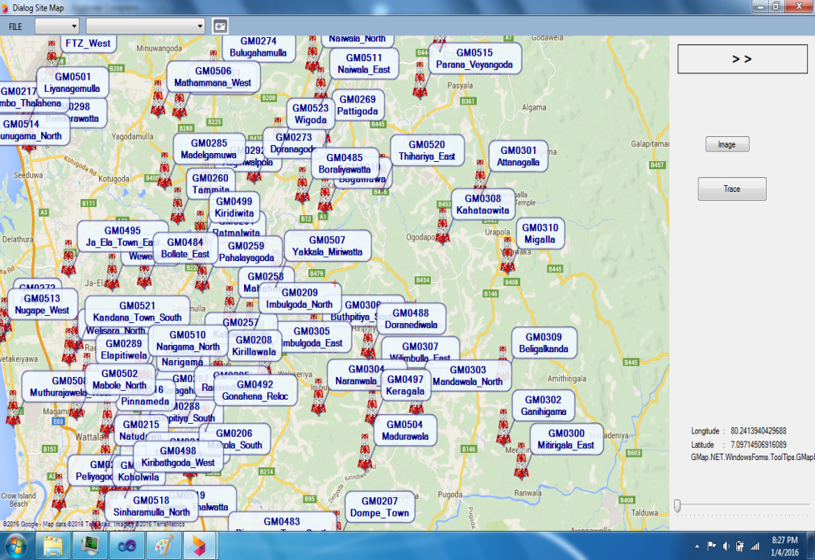
Dialog User Desktop Application

Slide 14
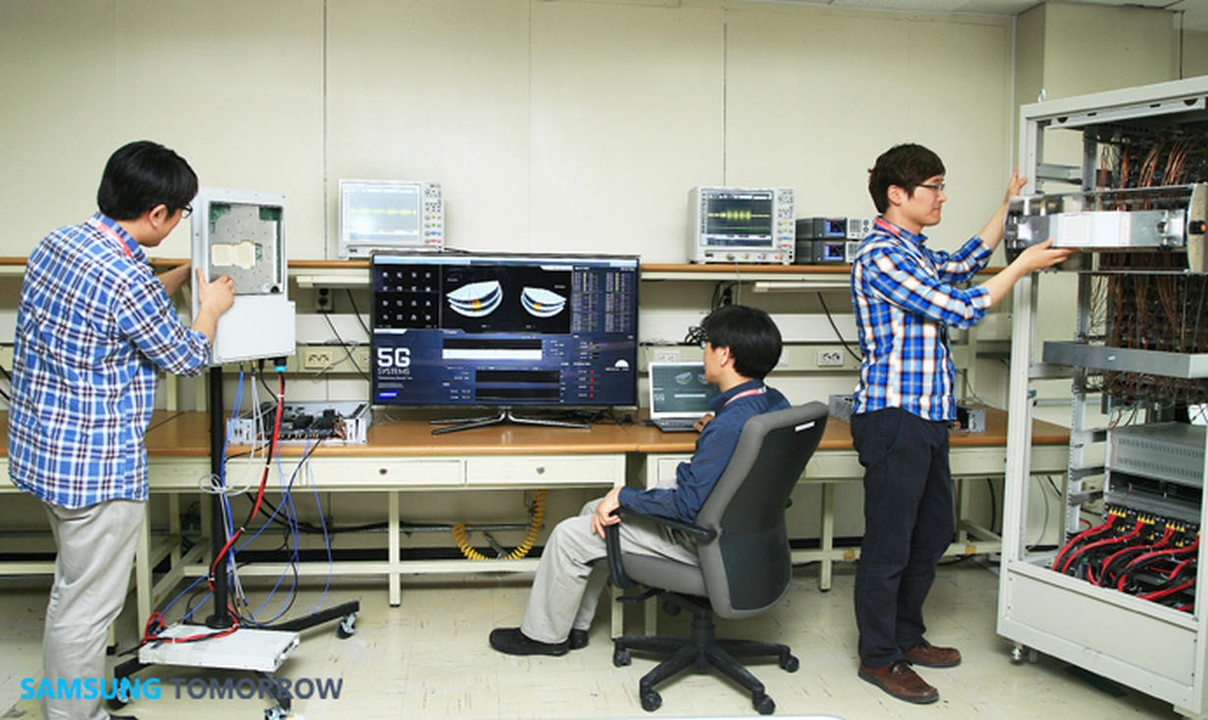
PROJECT LAYOUT

Slide 15
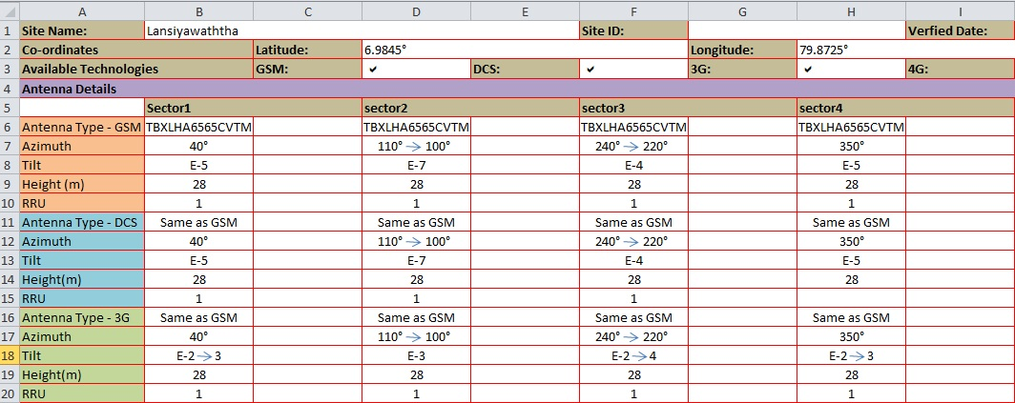
PROJECT PLANNING
Get information.

Slide 16
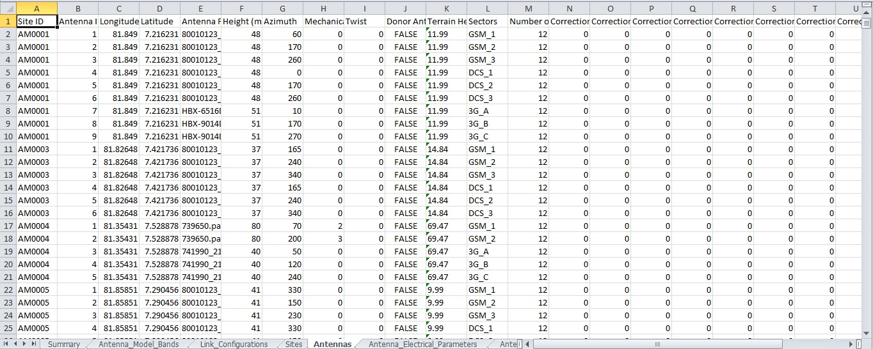
PROJECT PLANNING
Insert to database.

Slide 17
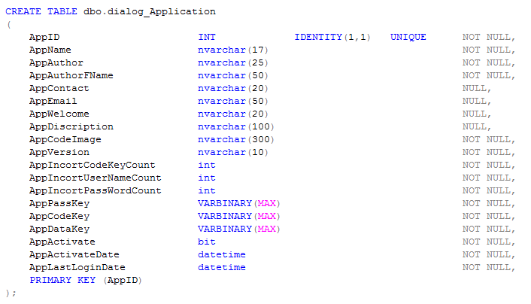
PROJECT PLANNING
MS SQL DATABASE CORDINS

Slide 18
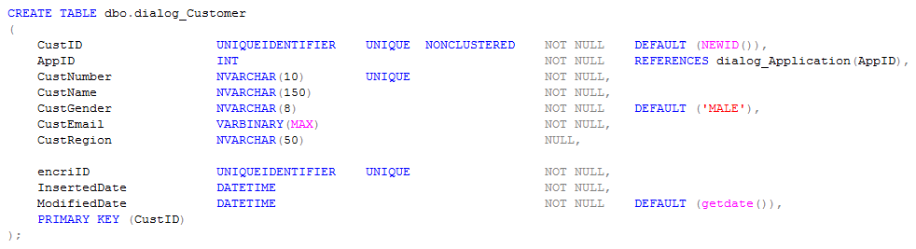
PROJECT PLANNING
MS SQL DATABASE CORDINS

Slide 19
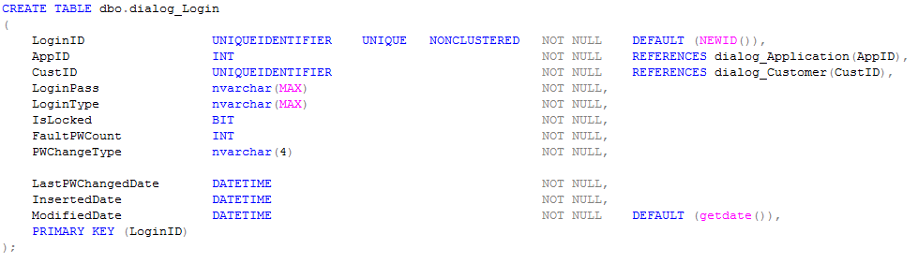
PROJECT PLANNING
MS SQL DATABASE CORDINS

Slide 20
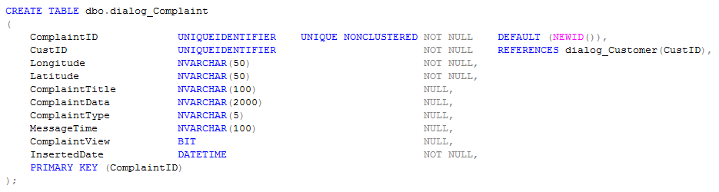
PROJECT PLANNING
MS SQL DATABASE CORDINS

Slide 21
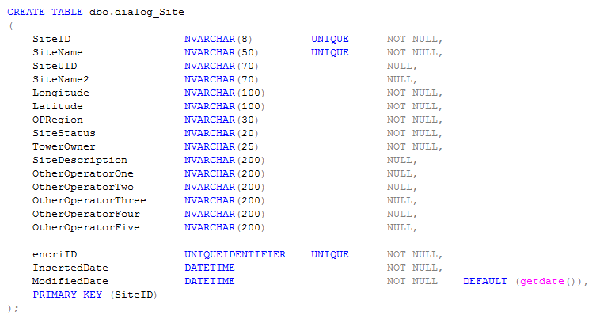
PROJECT PLANNING
MS SQL DATABASE CORDINS

Slide 22
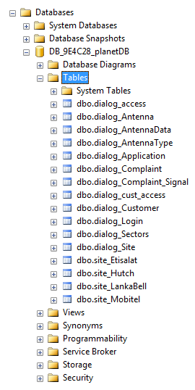
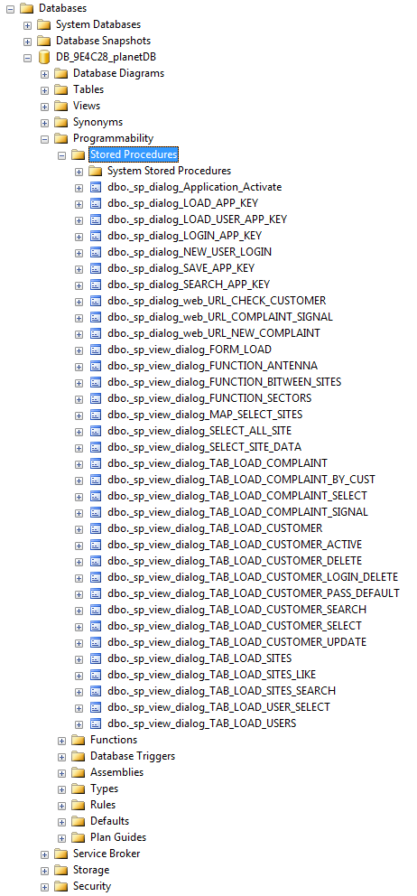
PROJECT PLANNING
MS SQL DATA TABLES
MS SQL STORED PROCEDURE

Slide 23
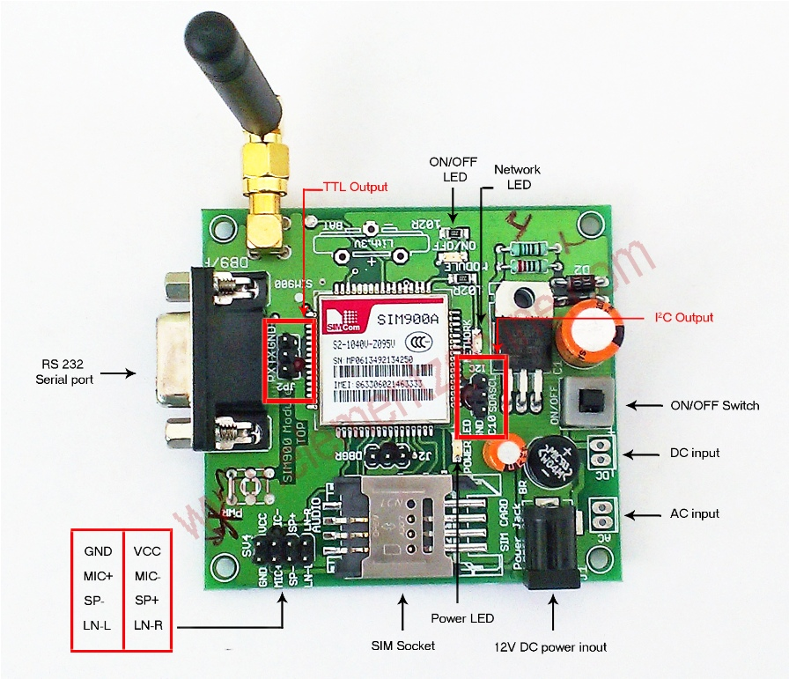
PROJECT PLANNING
GSM SMS module.
SIM 900 A GSM MODULE

Slide 24
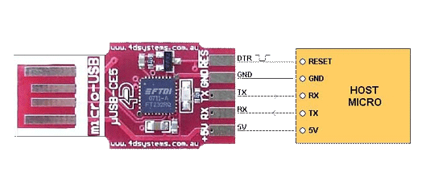
PROJECT PLANNING
GSM SMS module.
TTL TO USB CONVERTER

Slide 25
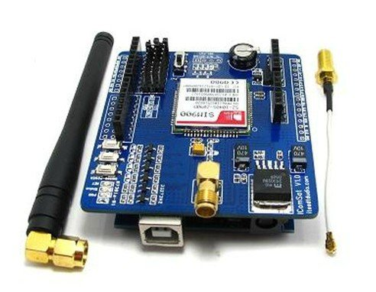
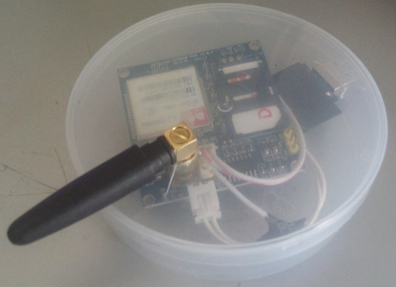
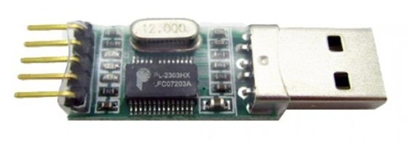
PROJECT PLANNING
Designing the GSM SMS module.

Slide 26
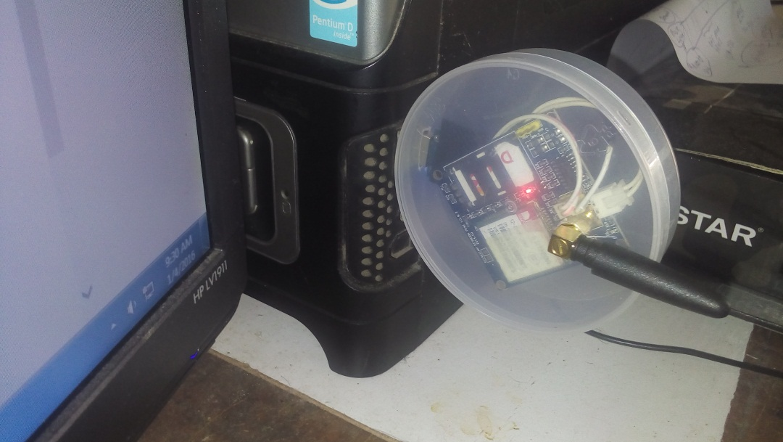
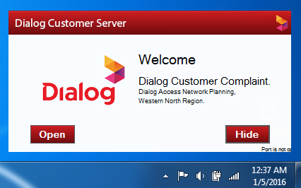
PROJECT PLANNING
GSM Equipment
PC Software

Slide 27


PROJECT PLANNING
Testing the server

Slide 28
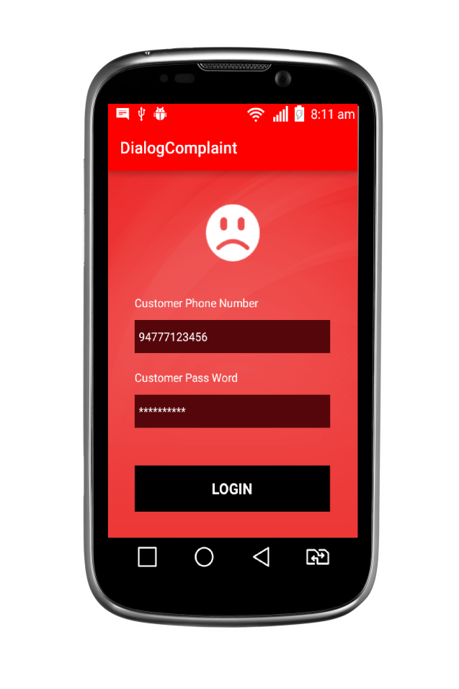
PROJECT PLANNING
Designing the mobile application

Slide 29
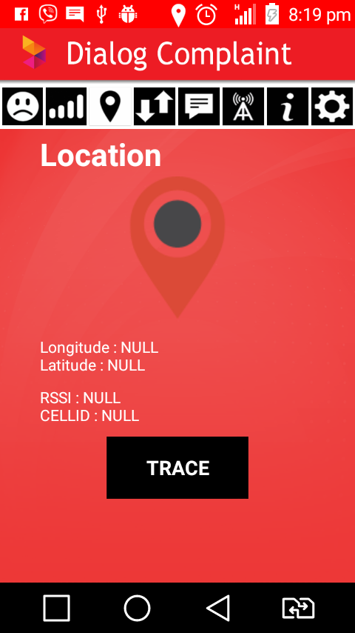
PROJECT PLANNING
Designing the mobile application

Slide 30
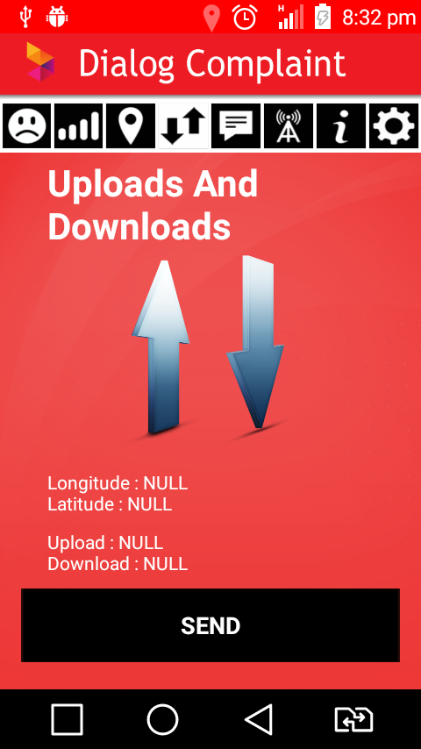
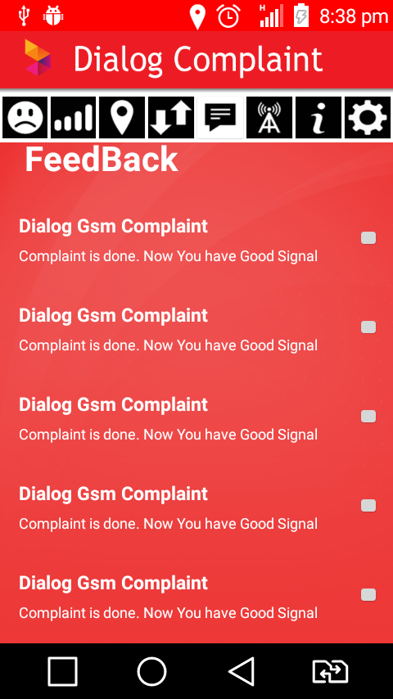
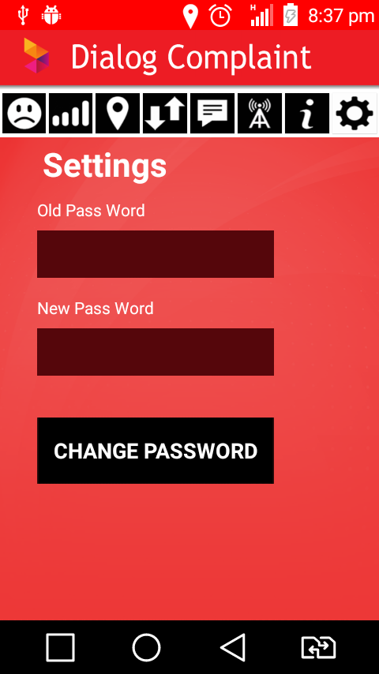
PROJECT PLANNING
Designing the mobile application

Slide 31
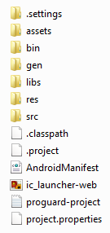
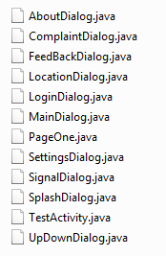
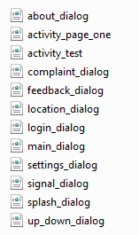
PROJECT PLANNING
Android Project Files
Android Java Files
Android Xml Files

Slide 32

Desktop Application
Testing the mobile application

Slide 33

Dialog User Desktop Application
Testing the mobile application

Slide 34
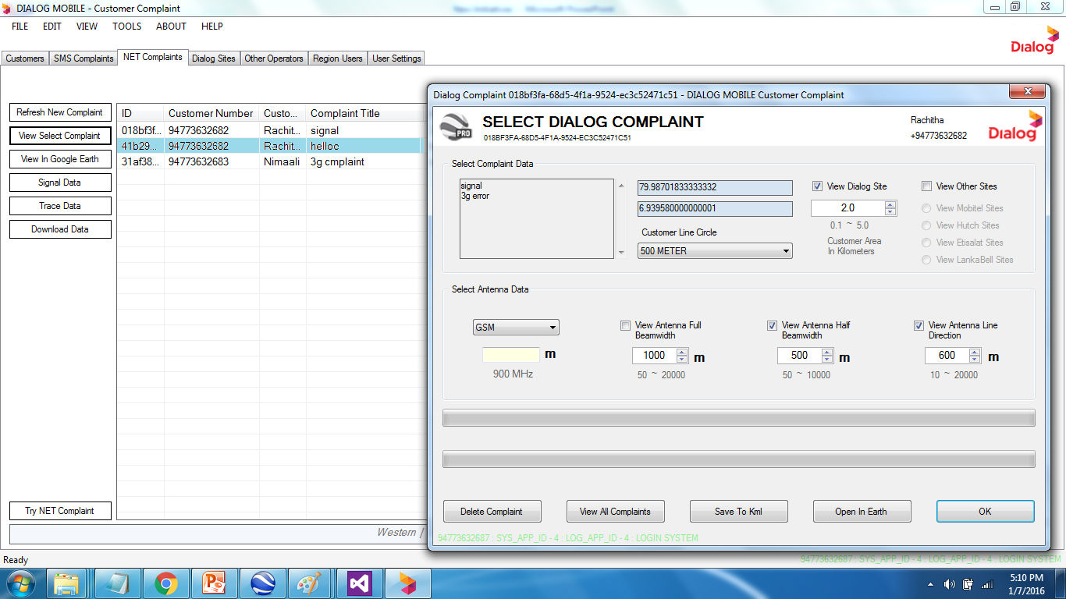
Dialog User Desktop Application
Testing the mobile application

Slide 35
Dialog User Desktop Application

Slide 36
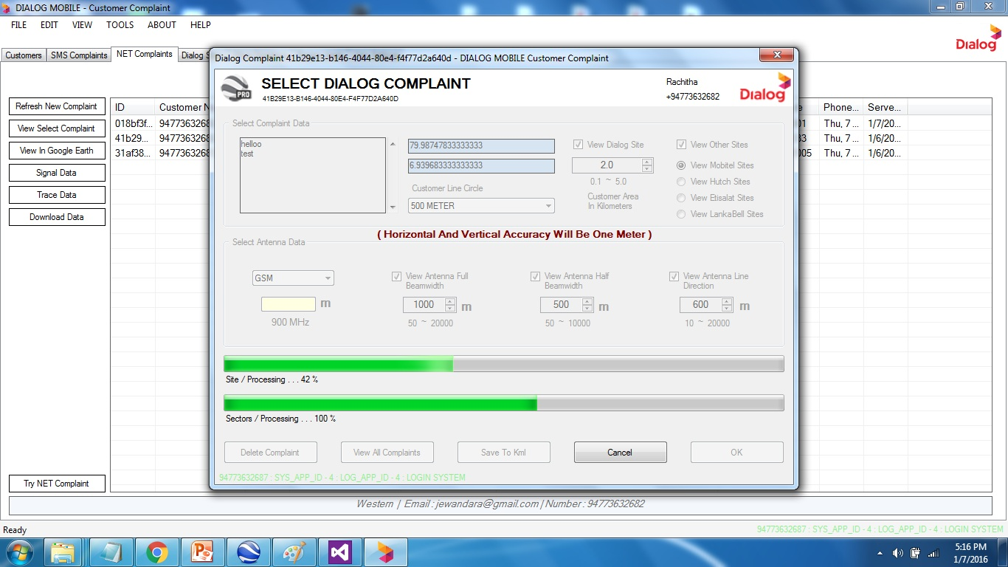
Dialog User Desktop Application

Slide 37

Dialog User Desktop Application

Slide 38

Dialog User Desktop Application

Slide 39

Dialog User Desktop Application

Slide 40

Dialog User Desktop Application

Slide 41

Dialog User Desktop Application

Slide 42

Dialog User Desktop Application

Slide 43

Dialog User Desktop Application

Slide 44

Dialog User Desktop Application

Slide 45

Our Final Objective
Assume Coverage

Slide 46
MARKET RESEARCH
Dialog Server software is a very easy to handle, because data entering & delete in very easy.
Planning Engineer does not need good computer knowledge, but he can handle this software.

Slide 47



MARKET RESEARCH
There are different types of signal trace software. But any of them can use for mobile customer complaints.

Slide 48
TECHNICAL RESEARCH
I used web research programming language. Ex:http://www.stackoverflow.com/
And used web research for developing the project.
And I visited many mobile towers to get more information about the Dialog site and antenna data.

Slide 49


IMPLEMENTATION
Smart Phone with GPS
Phone GPS Data / Signal Data
URL LINK
MS SQL SERVER

Slide 50



IMPLEMENTATION
Normal Phone without GPS
Phone GPS Data
SIM900A GSM Module
PC - Computer
MS SQL SERVER

Slide 51


IMPLEMENTATION
Dialog User Interface
MS SQL SERVER
PC - Computer
User UGI

Slide 52


THANK YOU !

